Slide 1
Chapter 7: Explore the Network
Introduction to Networks v5.1

Slide 2
Chapter Outline
7.0 Introduction
7.1 IPv4 Network Addresses
7.2 IPv6 Network Addresses
7.3 Connectivity Verification
7.4 Summary

Slide 3
Section 7.1: IPv4 Network Addresses
Upon completion of this section, you should be able to:
Convert between binary and decimal numbering systems.
Describe the structure of an IPv4 address including the network portion, the host portion, and the subnet mask.
Compare the characteristics and uses of the unicast, broadcast, and multicast IPv4 addresses.
Explain public, private, and reserved IPv4 addresses.

Slide 4
Topic 7.1.1: Binary and Decimal Conversion

Slide 5
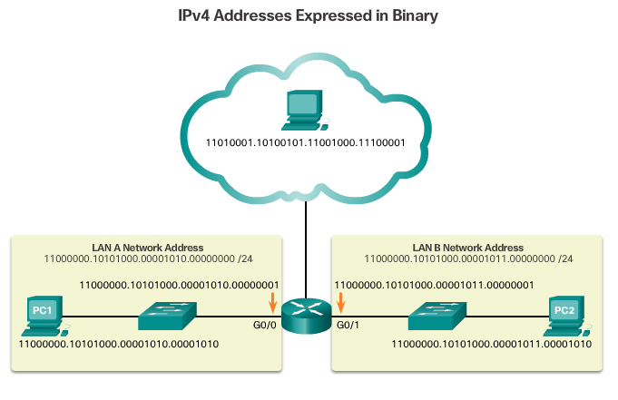
IPv4 Addresses
Notes:
7.1.1.1 IPv4 Addresses

Slide 6
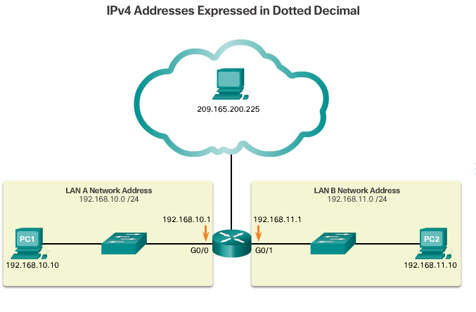
IPv4 Addresses (cont.)
Notes:
7.1.1.1 IPv4 Addresses (Cont.)

Slide 7
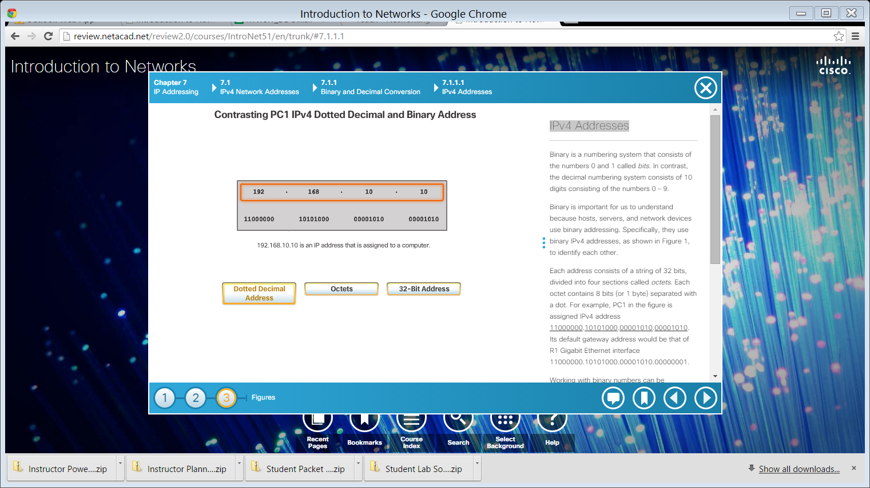
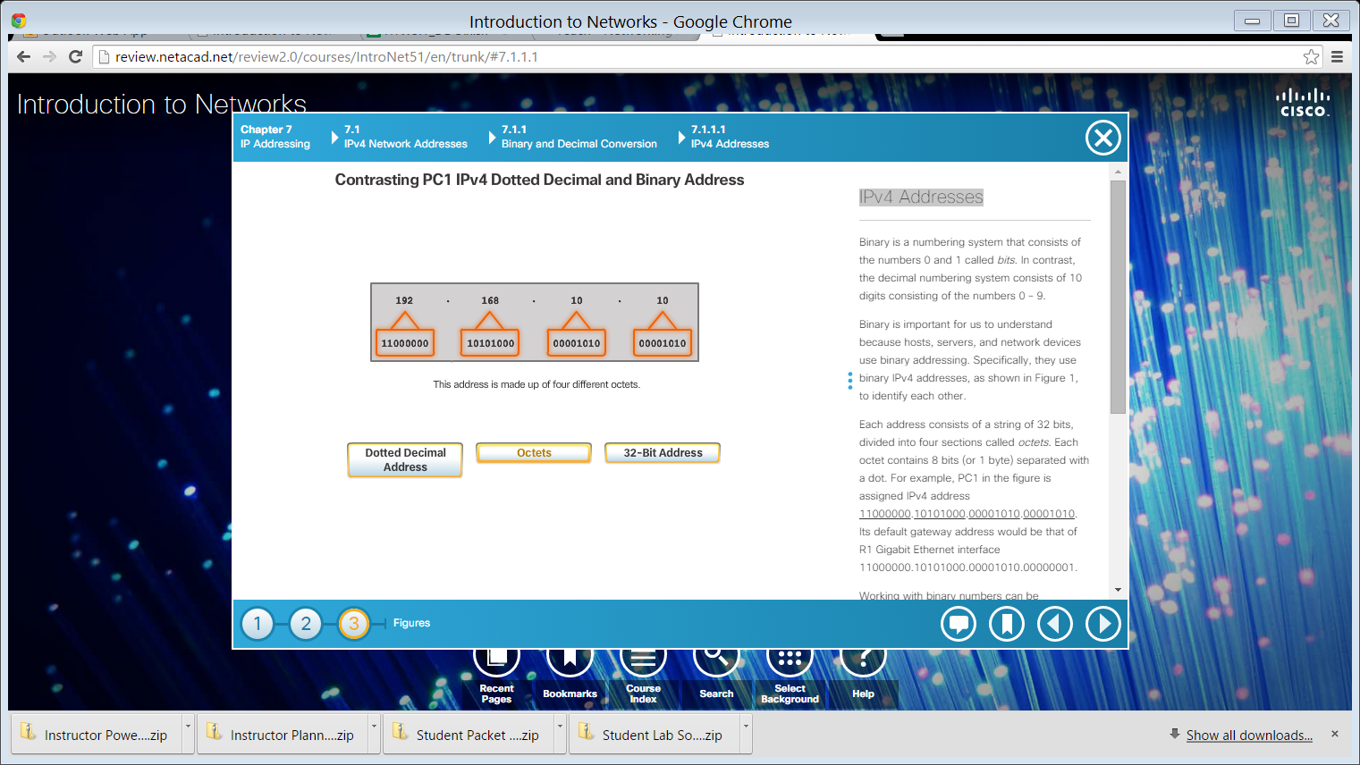

IPv4 Addresses (cont.)
Dotted Decimal Address
Octets
32-Bit Address
Notes:
7.1.1.1 IPv4 Addresses (Cont.)
7.1.1.2 Video Demonstration – Converting Between Binary and Decimal Numbering Systems

Slide 8
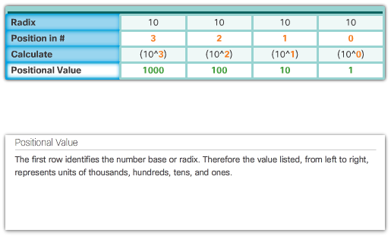
Positional Notation
Decimal Positional Notation
Notes:
7.1.1.3 Positional Notation

Slide 9
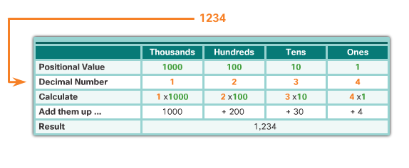
Positional Notation (cont.)
Applying Decimal Positional Notation
Notes:
7.1.1.3 Positional Notation (Cont.)

Slide 10
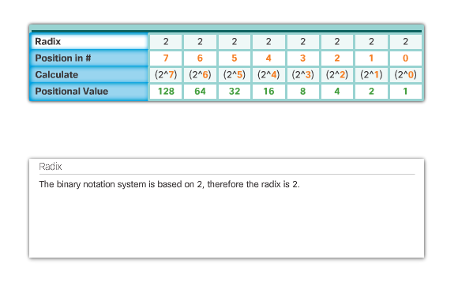
Positional Notation (cont.)
Binary Positional Notation
Notes:
7.1.1.3 Positional Notation (Cont.)

Slide 11
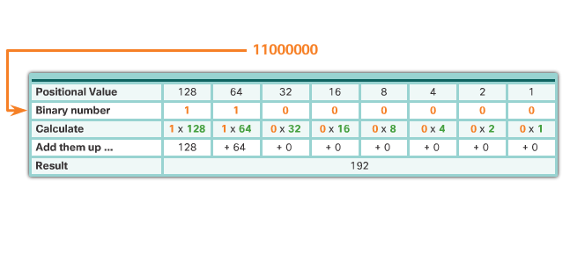
Positional Notation (cont.)
Applying Binary Positional Notation
Notes:
7.1.1.3 Positional Notation (Cont.)

Slide 12
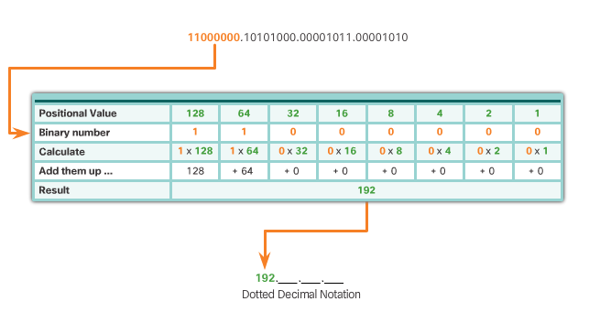
Binary to Decimal Conversion
To convert a binary IPv4 address to its dotted decimal equivalent:
Divide the IPv4 address into four 8-bit octets. Apply the binary positional value to the first octet binary number and calculate accordingly.
Repeat for each octet.
Notes:
7.1.1.4 Binary to Decimal Conversion

Slide 13

Binary to Decimal Conversion (cont.)
Notes:
7.1.1.4 Binary to Decimal Conversion (Cont.)

Slide 14

Binary to Decimal Conversion (cont.)
Notes:
7.1.1.4 Binary to Decimal Conversion (Cont.)

Slide 15

Binary to Decimal Conversion (cont.)
Notes:
7.1.1.4 Binary to Decimal Conversion (Cont.)
7.1.1.5 Activity – Binary to Decimal Conversion

Slide 16
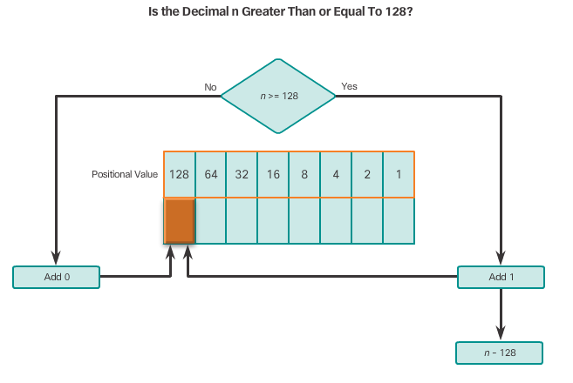
Decimal to Binary Conversion
The following illustrates how to use the binary positional value table to convert decimal to binary.
Notes:
7.1.1.6 Decimal to Binary Conversion

Slide 17
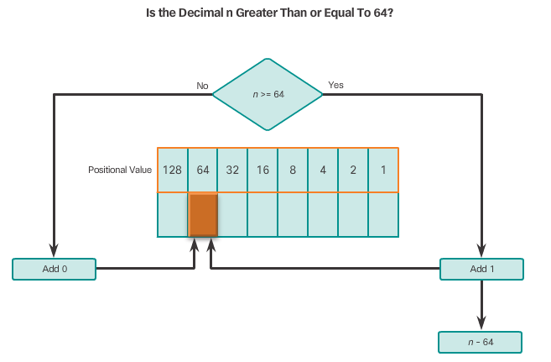
Decimal to Binary Conversion (cont.)
Notes:
7.1.1.6 Decimal to Binary Conversion (Cont.)

Slide 18
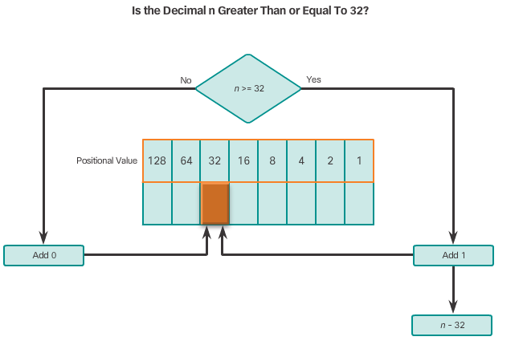
Decimal to Binary Conversion (cont.)
Continue to evaluate the decimal until all positional values have been entered, which results in the equivalent binary value.
Notes:
7.1.1.6 Decimal to Binary Conversion (Cont.)

Slide 19
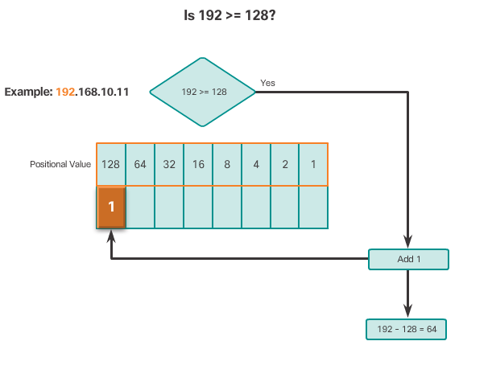
Decimal to Binary Conversion Example
Notes:
7.1.1.6 Decimal to Binary Conversion Examples

Slide 20
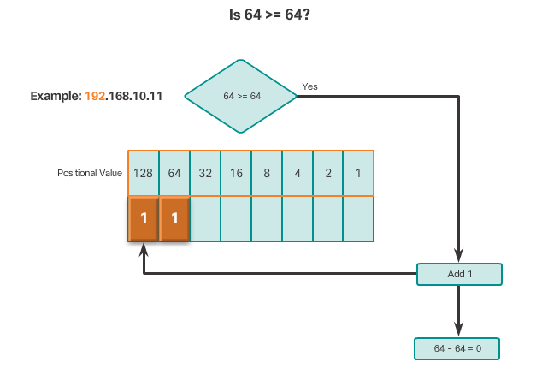
Decimal to Binary Conversion Example (cont.)
Notes:
7.1.1.6 Decimal to Binary Conversion Example (Cont.)

Slide 21
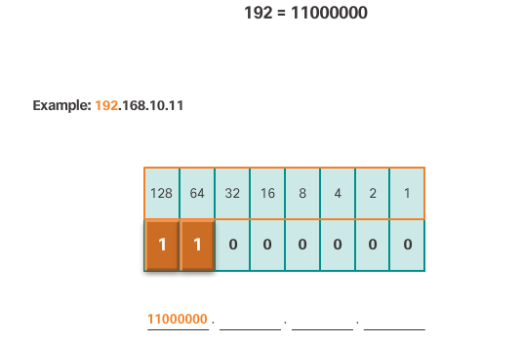
Decimal to Binary Conversion Example (cont.)
See VIDEO DEMONSTRATION
Notes:
7.1.1.6 Decimal to Binary Conversion Example (Cont.)
7.1.1.7 Video Demonstration – Decimal to Binary Conversion
7.1.1.8 Activity – Decimal to Binary Conversion
7.1.1.9 Activity - Binary Game

